Slide 1
Visualization of radon measurements
A project of the GeoViz Ltd.
Notes:
Task: What is given and what is the target?
Development of Webapplication
Visualization of statistical values from radon measurements
How are we going to do that?

Slide 2
Agenda
GeoViz Ltd.
Radon
System Architecture
Data
GUI
License
Project Plan and Gantt Chart
Notes:
To GeoViz Ltd.: Company; Team
Why is Radon interesting?
System archi -> how to built up system on back end (admin side)
Which data use?
GUI -> how front end looks like
Which data and which licences are used -> result in which licence and what do we think about our work?
Expansion of project

Slide 3
The Team
Georg Stubenrauch Spatial Analysis Engineer
Rajesh Mahalingam Software Developer
Md Kamrul Ahsan Software Developer
Sebastian Lemstra Project Management
Notes:
GeoViz to our company
Located from karlsruhe
Team built up from 4 people
All students of HS Karlsruhe
Studies Geomatics but they come from different directions
Differnet backgrounds and experts on different skills
United we cover everything and perfect to solve such tasks

Slide 4
Georg Stubenrauch
Spatial Analysis Engineer
Skills:
JavaScript
jQuery UI
OpenLayers v2
GeoServer
B.Sc. Geoinformationsmanagement
Notes:
Welcome
name is Georg Stubenrauch
Spatial Analysis Engineer of our company
studied Geo-Information Management at the University of Applied Sciences in Karlsruhe
My main focus lies on: Geoinformation Systems, JavaScript, OpenLayers and GeoServer
latest tasks: development of a slider-functionality to visualize the time component of given wind measurements

Slide 5
Rajesh Mahalingam
Software Developer
Skills:
leaflet
HTML5
JavaScript
Java
Geoinformation Systems
B.Tech. Geotechnology and Geoinformatics
Notes:
GeoViz to our company
Located from karlsruhe
Team built up from 4 people
All students of HS Karlsruhe
Studies Geomatics but they come from different directions
Differnet backgrounds and experts on different skills
United we cover everything and perfect to solve such tasks

Slide 6
Mohammed Kamrul Ahsan
Software Developer
Skills:
HTML5
CSS
JavaScript
Geoinformation Systems
B.Sc. Electrical and Electronic Engineering (EEE)
Notes:
GeoViz to our company
Located from karlsruhe
Team built up from 4 people
All students of HS Karlsruhe
Studies Geomatics but they come from different directions
Differnet backgrounds and experts on different skills
United we cover everything and perfect to solve such tasks

Slide 7
Sebastian Lemstra
Project Management
Skills:
Visualization of (Geo-) Data, Cartography
Webdesign
Geoinformation Systems
Project Management
B.Sc. Cartography and Geomatics
Notes:
GeoViz to our company
Located from karlsruhe
Team built up from 4 people
All students of HS Karlsruhe
Studies Geomatics but they come from different directions
Differnet backgrounds and experts on different skills
United we cover everything and perfect to solve such tasks

Slide 8
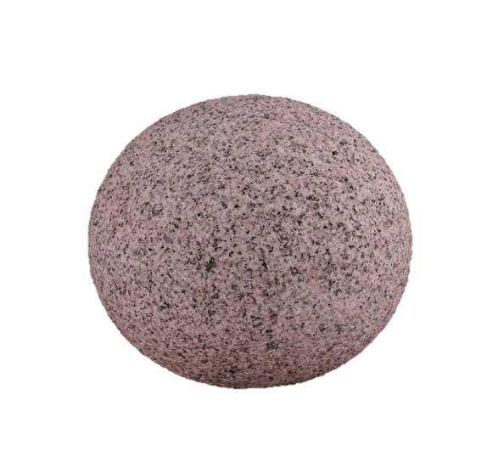
Radon
Rn
86
Properties
Colourless
Odorless
Tasteless
Chemically inert radioactive gas
Sources
Natural radioactive decay of uranium to Plumbum
222
Radon

Slide 9
Radiation exposure

Slide 10
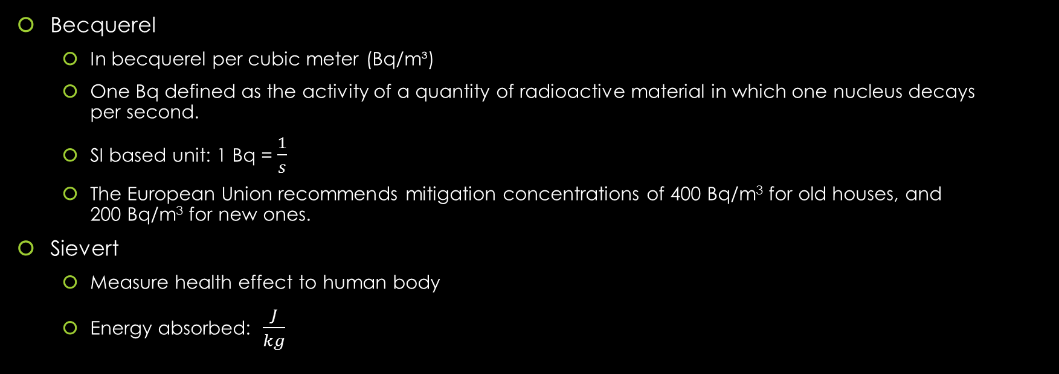
Radiation units
Becquerel
In becquerel per cubic meter (Bq/m³)
One Bq defined as the activity of a quantity of radioactive material in which one nucleus decays per second.
SI based unit: 1 Bq = $\frac{1}{s}$
The European Union recommends mitigation concentrations of 400 Bq/m³ for old houses, and 200 Bq/m³ for new ones.
Sievert
Measure health effect to human body
Energy absorbed: $\frac{J}{kg}$

Slide 11
Measuring Radiation
A scintillation counter is an instrument for detecting and measuring ionizing radiation.
The sievert (sv) is a measure of the health effect of low levels of ionizing radiation on the human body.
measuring in
Air
Ground
In houses

Slide 12
Occurence
Soil
Entering building through holes in the basement
Radon enriches in air
Notes:
Radon in soil
Is released into pore spaces of soil and rocks
Radon in buildings
Mostly entered directly from soil trough lowes building levels contacted to the ground

Slide 13
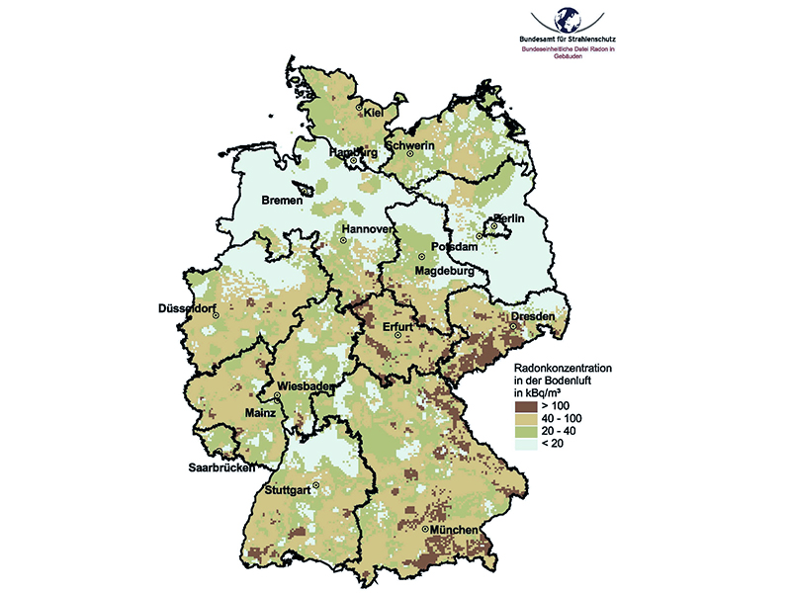
Health effects
Exposure to high concentrations of radon will lead to lung cancer or a lung disease
estimated to contribute to about 2% of all cancer related deaths in Europe

Slide 14
System requirements
Backend
easy and quick to set up
good documentation / support
possibility to adapt to personal needs
Frontend
Usability
all necessary functions included (e.g. Google Maps)
support of mobile devices
low system requirements
no performance issues
Notes:
Description of how web app will be realized
First look at system requirements
Two categories:
Backend = developer
Set up of system easy and quick
Good documentation and support made available
Helps to adapt to personal needs
Frontend = user
Most important: usability
Functions know by using Google maps to be included e.g. zomming, panning
Support of mobile devices → use anywhere by anyone
Low system requirements and no performance issues → no hinderance of user experience

Slide 15
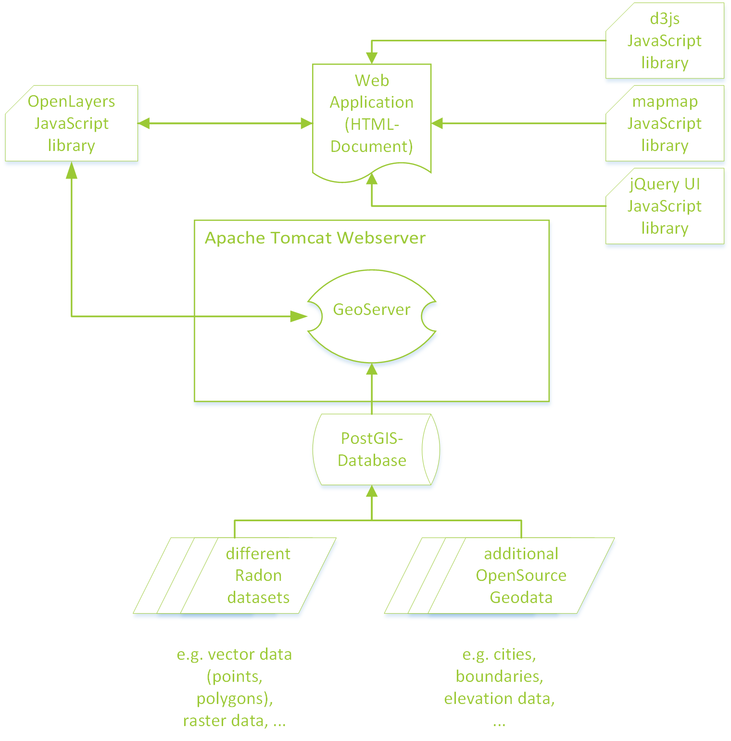
System architecture
Notes:
System requirements as basis for architecture
Data:
Radon datasets: point features and raster datasets for project area
Add. Datasets: cities, boundaries, elevation data, …
PostGIS:
Datasets imported to PostGIS database
Data access much faster
Performance can be increased →important for front- and backend
GeoServer:
to publich datasets in web app
OGC compliant
Supports open standards: WMS, WFS, ..
Supports Shapefiles and PostGIS databases
OpenLayers:
integration of interactive maps in a web application
three major webclients or JavaScript libraries:
OL v2
OL v3
Leaflet
Leaflet regarded as easier alternative
OL more functions
OL v3 because of improvements
D3js:
Data-driven-documents
Display data in dynamic graphical form
Different ways to visualize Radon measurements
Create unique interactive and attractive app
Mapmap:
Presentation in Vienna about mipmap
Developed to simplify creation of interactive thematic maps
Build on top of d3js
Both libraries to combine functions
No complications expectet
jQuery UI:
Used to create GUI
Built on top of jQuery, required by mapmap
jQuery: cross-Browser support -> all browsers on all devices
jQuery UI: simple control elements (buttons, checkboxes, …) advanced widgets (menus, progressbars, …)

Slide 16
Data
Additional data
Roads, Streets, …
Elevation
Hillshade
Additional thematic data
image
Radon measurements
Notes:
Radon measurements
In house
In air
In ground
Topographic data
- not only in germany -> not ISLAND
- streets, administrative borders, land use , llabels
Correlating data
Older data → comparison over time
- Data behind for SEARCH purposes

Slide 17
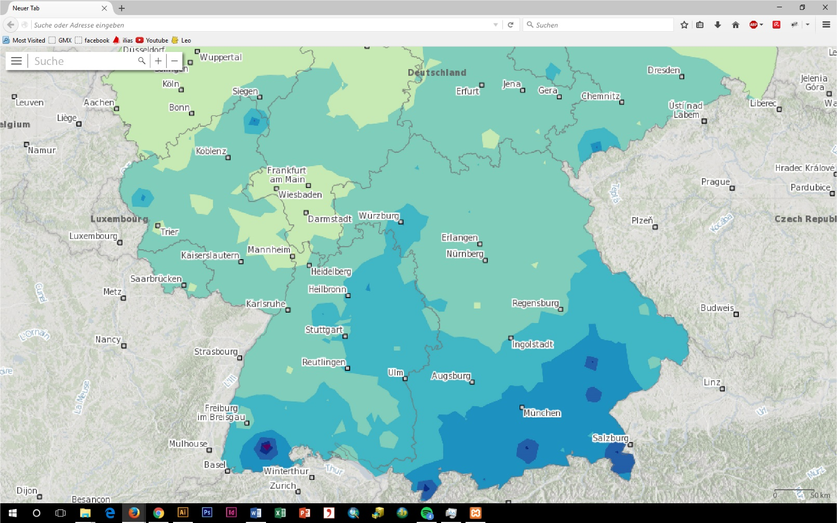
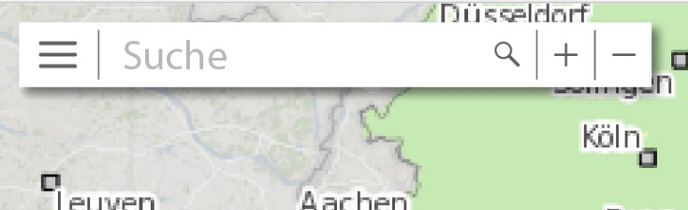
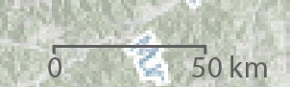
Mockup of GUI - Overview
Overview
Collapsed menu
Notes:
EMPTY – BUT WHAT WANT DO WE WANT TO VIZU
Simple
First line we want a full screen -> realise it
Only search function (for what?), menu button, zoom in out
The pan function is in this version not added with a button
Could be done for barrier reduced version for people with reduced abilitises
______________________________________________________________
Quick look at the implementation
Map element created using OpenLayers
Different layers displayed in map element
GUI created with jQuery UI
Accordion widget used for layer selection, legend and thematic information

Slide 18
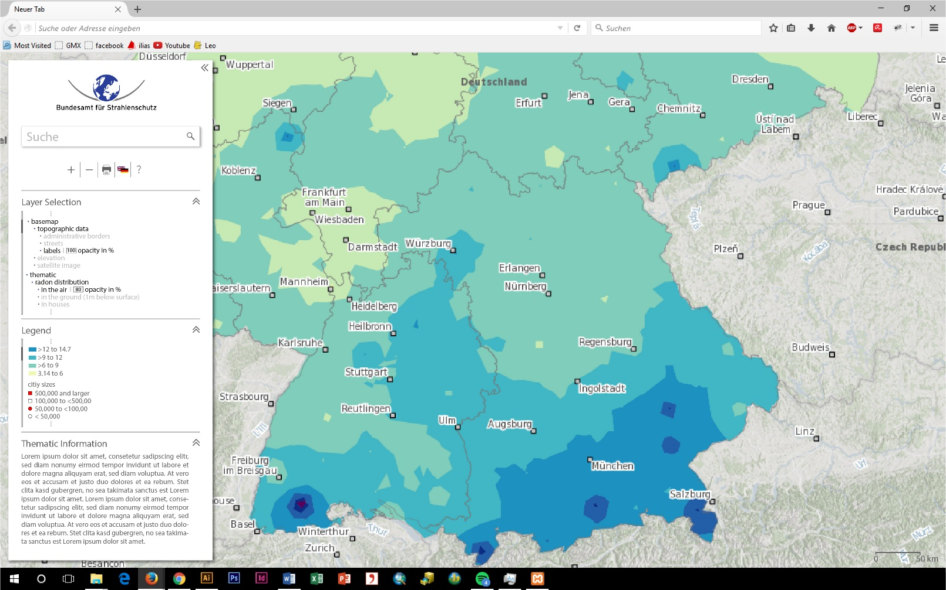
Mockup of GUI - Overview
Overview
opened menu

Slide 19
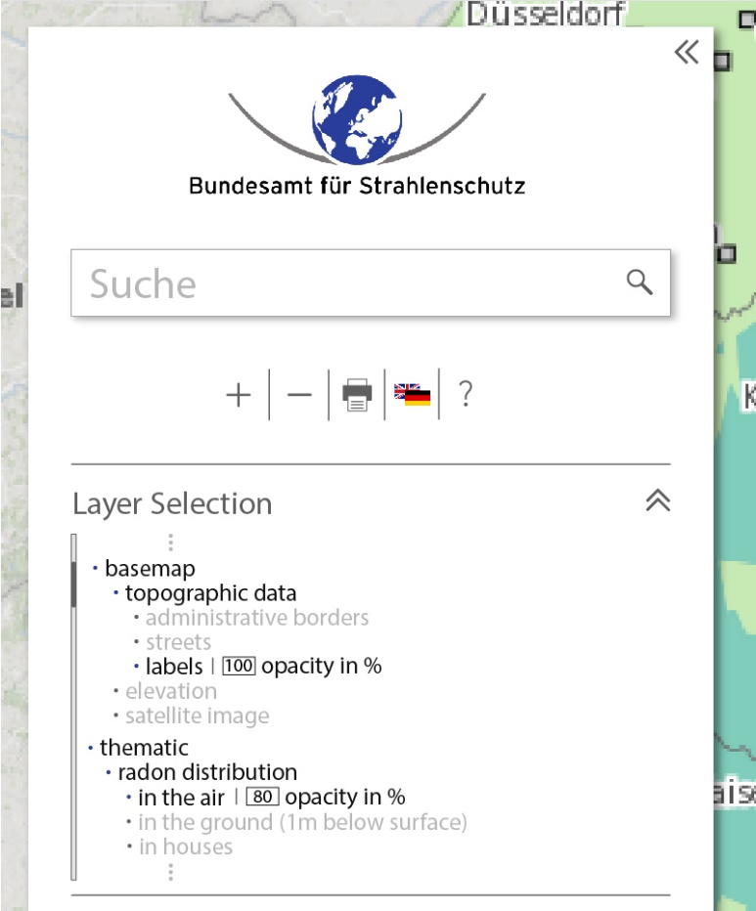
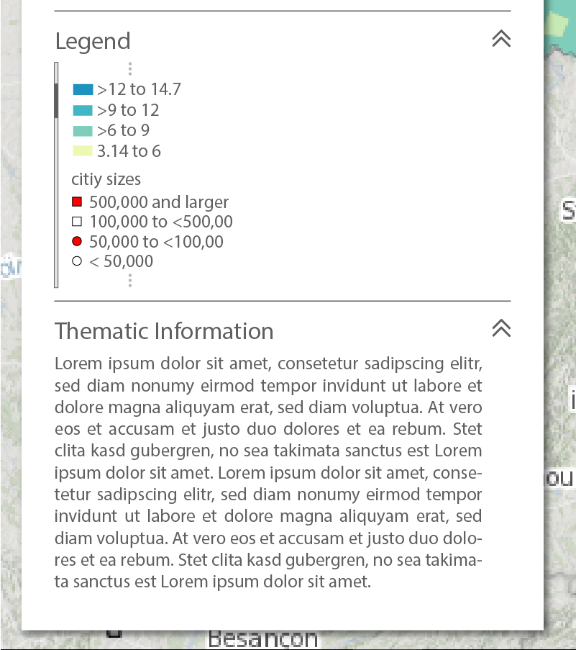
Mockup of GUI - The Menu
Upper part
Lower part
Notes:
Control elements used to interact with map
Click on plus / minus → zoom in / out of map by changing zoom level of map element
Advantage of using jQueryUI
Panels of Accordion can be collapsed and sorted without further coding

Slide 20
Open Source Licensing Models
GNU General Public License
BSD-style license
Other models:
Mozilla
I.B.M., Apple, Intel, RealNetworks, etc.
Artistic license
GNU Lesser GPL
Open Source Initiative (opensource.org)

Slide 21
BSD-Style License
License grant: unlimited use, modification, distribution
No warranties; disclaimer of consequential damages
No endorsement
Attribution

Slide 22
GNU – General Public License
Unlimited right to run program
Unlimited access to source code
Unlimited right to distribute verbatim copies
May create derivatives IF you agree to make the derivatives “free”
License is “viral”
No warranties; disclaimer of consequential damages

Slide 23
Licensing: the force behind open source
“Free” and “open” is not:
Public domain
Copyright “first sale”
Shareware or freeware
Licensing makes it work
Control over use
Risk shifting
“To stay free, software must be copyrighted and licensed.” Debian GNU/Linux Group

Slide 24
Prominent open source programs
Note: logos removed – just text
Apache
Linux
MySQL
FireFox
Notes:
Apache web server
Mozilla and firefox web browsers
Linux
Bind
MYSQL

Slide 25
Prominent open source vendors
Note: Logos removed – just text
IBM
Redhat (Linux)
Sun (Oracle)
Notes:
IBM
Red Hat
Sun Microsystems

Slide 26
Who uses open source software
At first: Hackers
Now: lots of people
Internet backbone: Apache, Sendmail, BIND
Linux
I.B.M., Intel, Apple, H.P., Sun
Commercial businesses
Federal and state governments
E.g., China, Mexico, Indonesia, Japan, Germany

Slide 27
Chosen license
MIT-Licence based
Free to use for everything
No warranty
Changes
Original link to source code added
Names added
New license: GeoViz License 1.0

Slide 28
Used libraries and languages
Mapmap.js
jQuery
D3js
Geofabrik (Data Source)
PostGIS
GeoServer
HTML, CSS

Slide 29
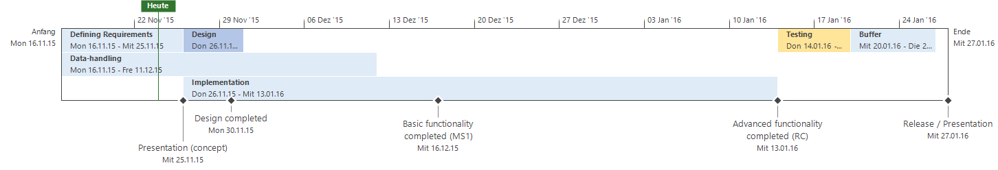
Project Plan
Notes:
Gantt chart
Definition of requirements ends today, results shown
Data-handling started with reception of Radon sample data
Acquisition of further datasets on its way
Analysis of datasets part of this phase
As well as calculation of raster datasets using given point features
Design phase generally finished before implementation
Start at the same time because of little time until Milestone 1
Possible since design of system architecture and GUI almost finished
Implementation / Development phase divided into two parts: Basic and Advanced Functionality
Basic: working GUI, all datasets implemented → Milestone 1
Advanced: search and print function, language switcher and dynamic legend → Release candidate
Testing phase will be used to find last errors → Release
Buffer to guarantee release on time

Slide 30
References
CSE P 590TU Lecture Slides and Video Archives, UNIVERSITY OF WASHINGTON.

Slide 31
Thank you for your attention! Questions?

